Slide 1



114學年度第一學期
親師懇談會
導師 ooo
114年9月0日

Slide 2


Table of Contents
01
自我介紹
02
03
04
05
06
班級經營
風格
教育理念
親師合作
聯繫方式
Q&A

Slide 3
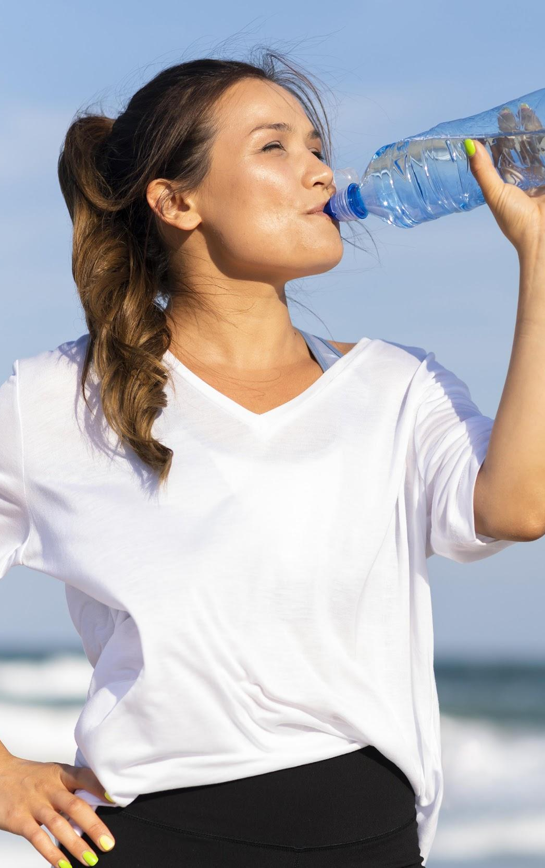
自我介紹
Mercury is the closest planet to the Sun and the smallest one in the Solar System—it’s only a bit larger than the Moon

Slide 4
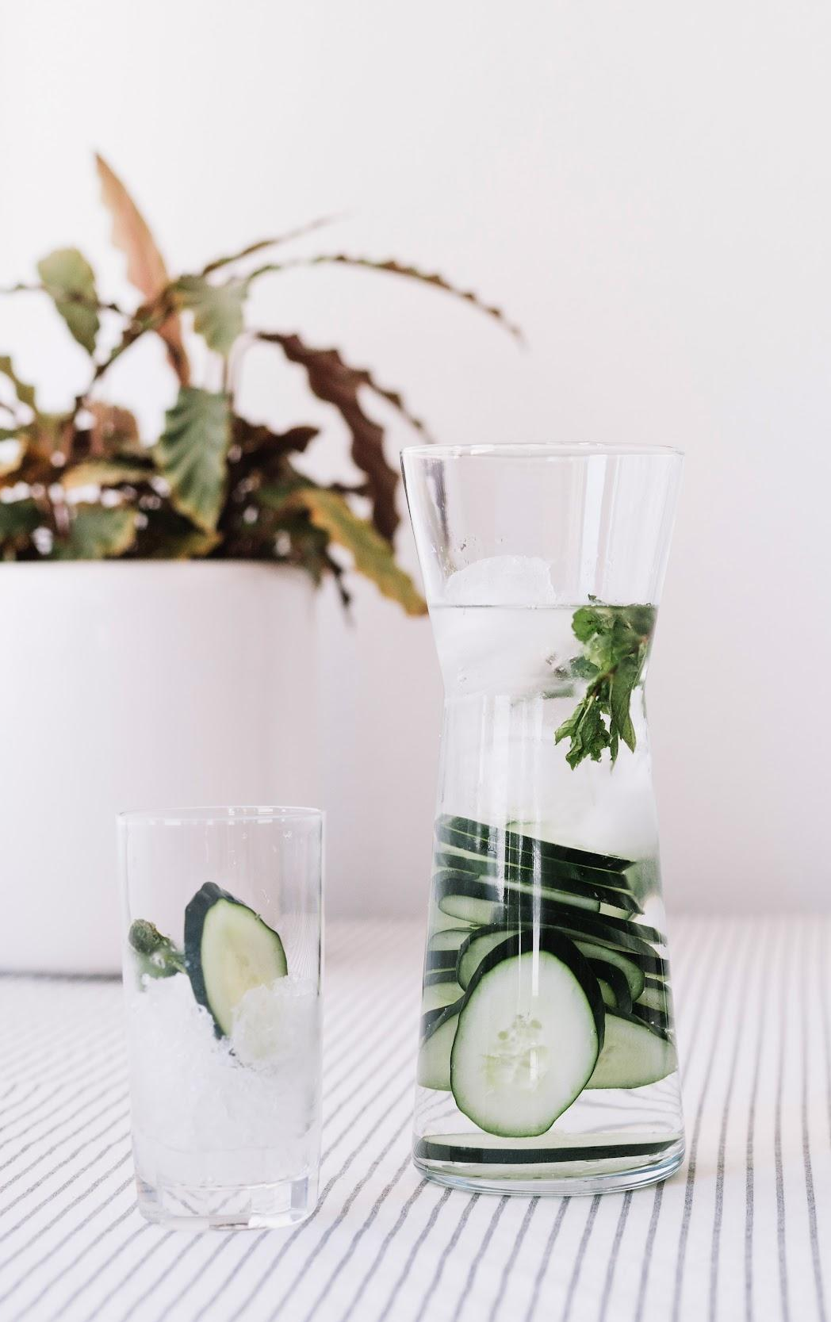
教育理念
Mercury is the closest planet to the Sun and the smallest one in the Solar System—it’s only a bit larger than the Moon

Slide 5
班級經營風格
100%
organic
A critical
mission
Trusted
partnership
Venus has a beautiful name, but also a poisonous atmosphere
It’s the smallest and innermost planet in the Solar System
It’s the sixth planet from the Sun and the second-largest

Slide 6

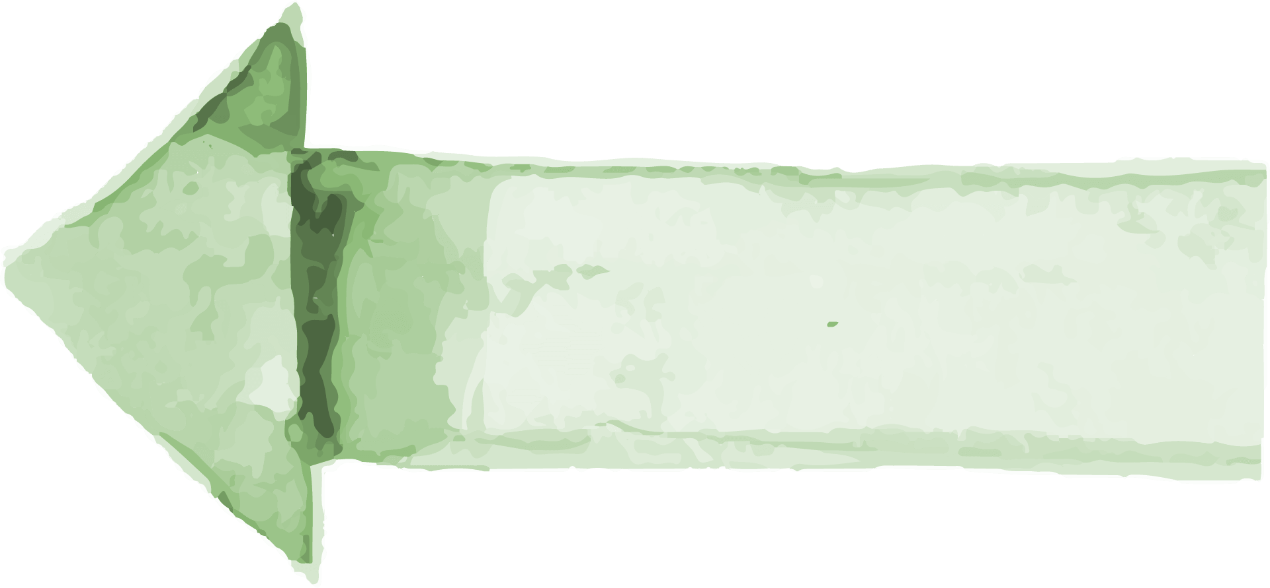
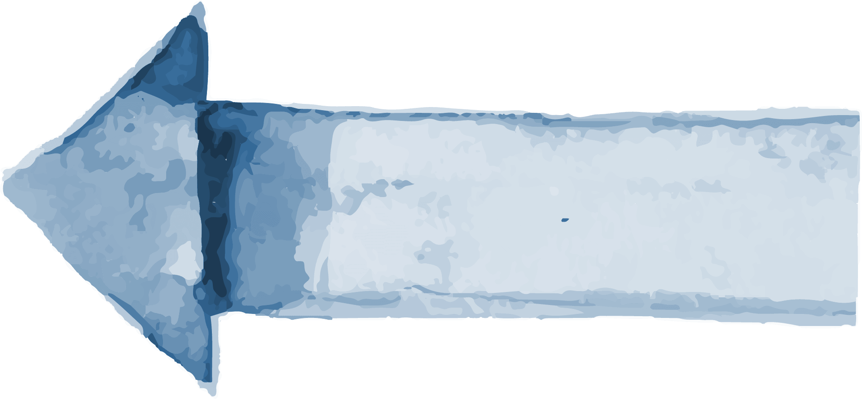
親師合作須知
01
02
03
Awareness
Consideration
Decision
Mercury is the closest planet to the Sun
Despite being red, Mars is a cold place
Jupiter is a gas giant and the biggest planet

Slide 7
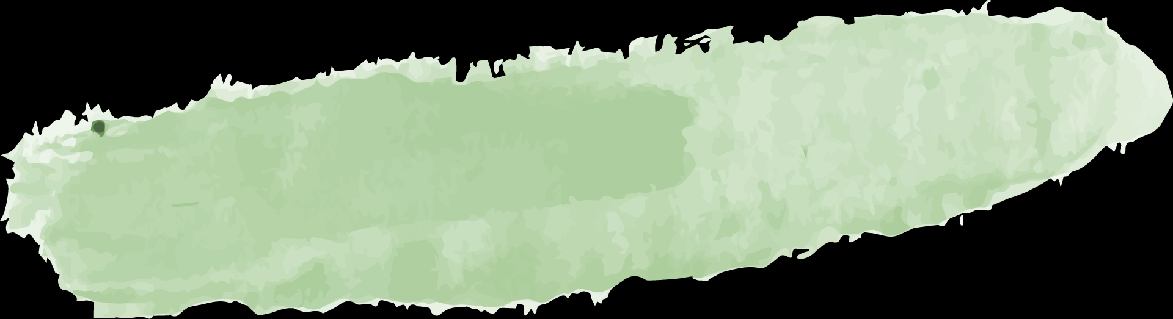
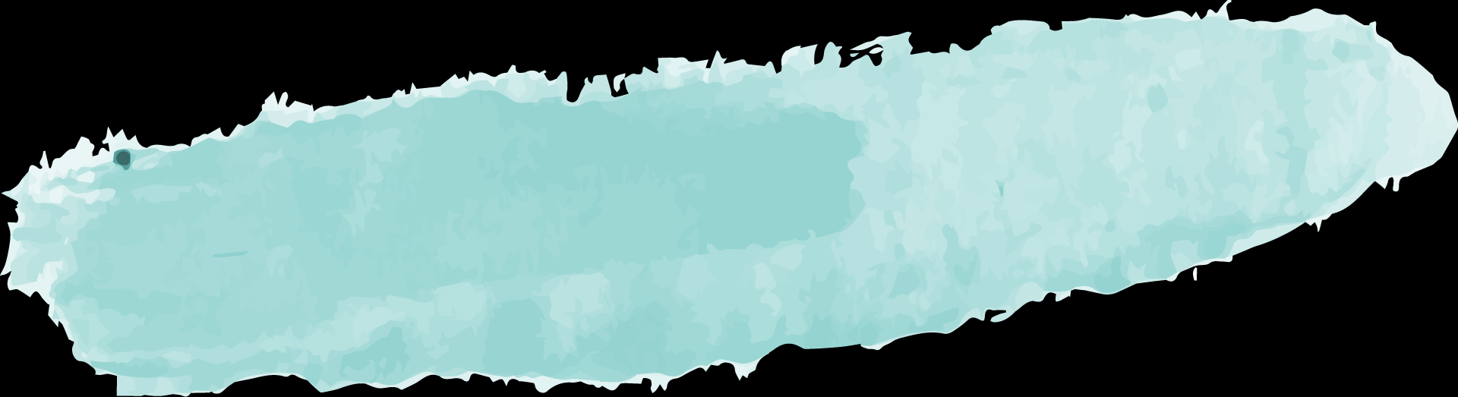

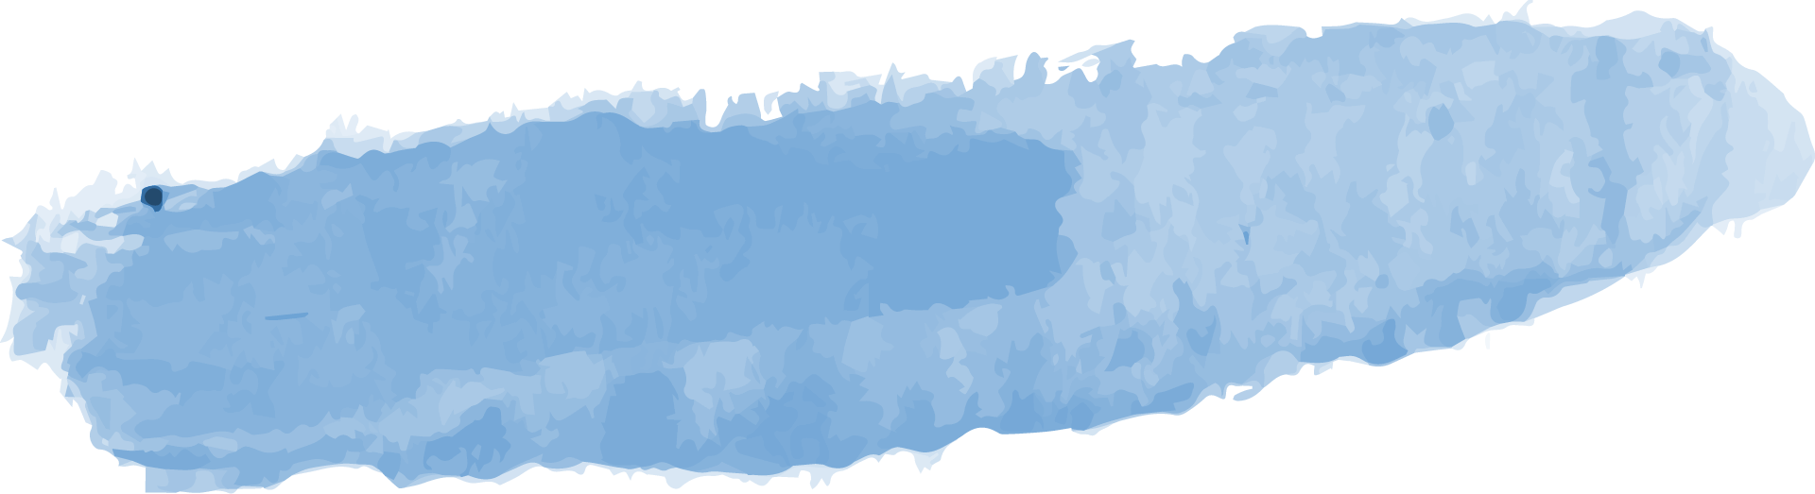
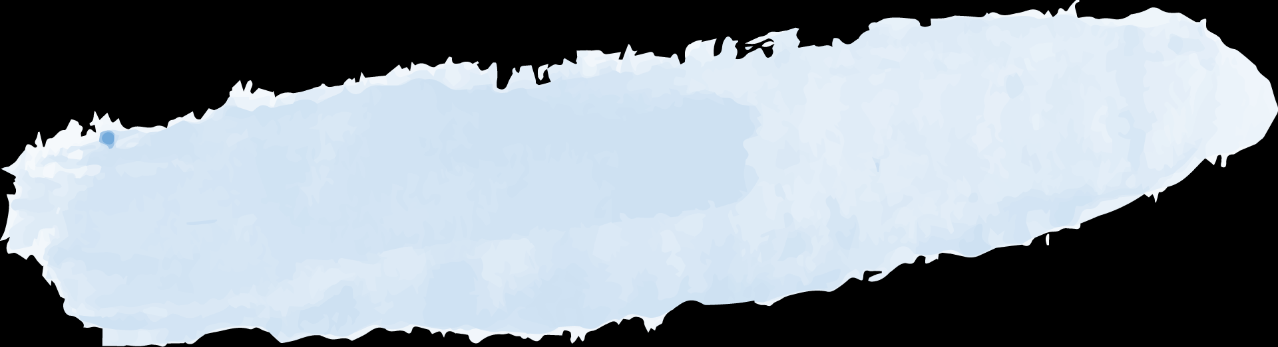
親師合作須知
Goal 1
Goal 3
Goal 2
Goal 4
Venus has a beautiful name, but also very high temperatures
Jupiter is a gas giant and the largest planet in the Solar System
Saturn is composed mostly of hydrogen and helium
Mercury is the smallest and innermost planet in the Solar System

Slide 8
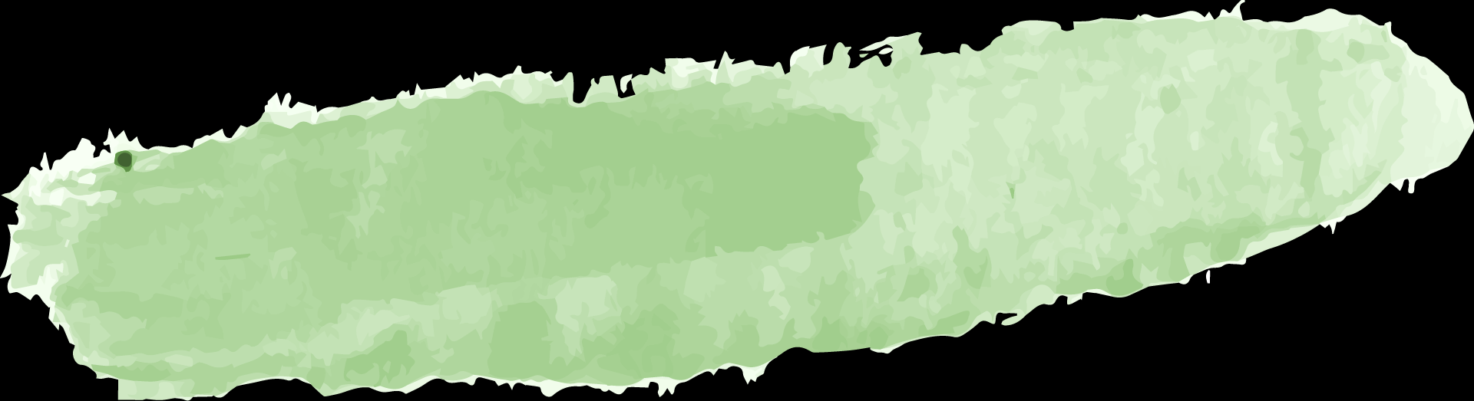
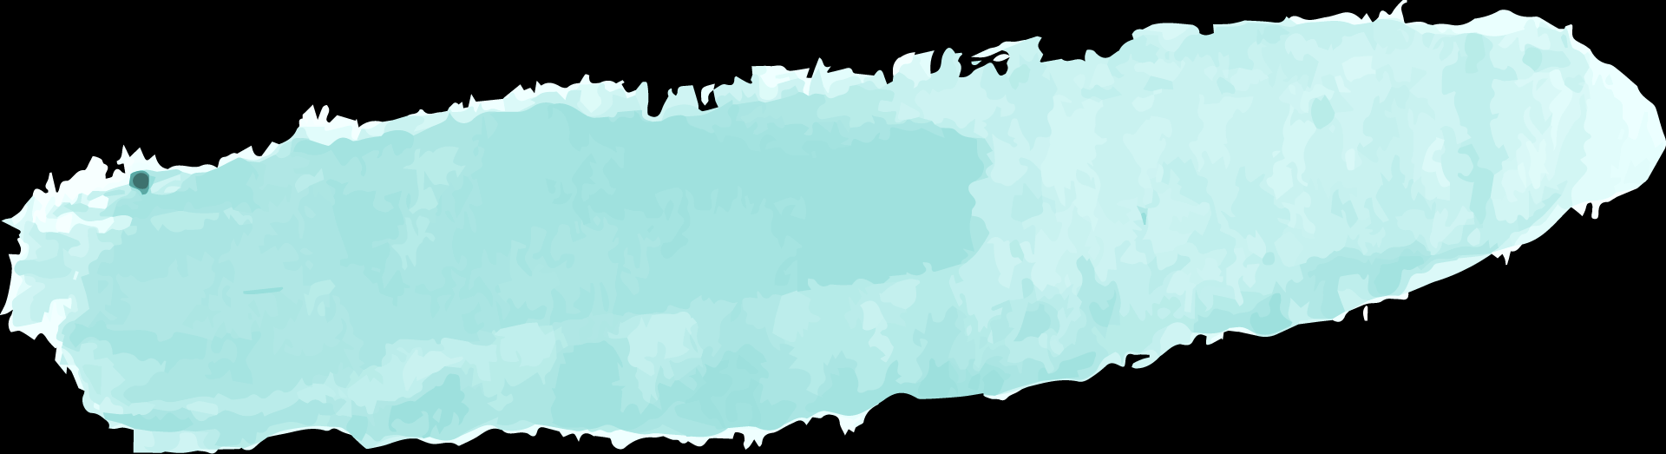
親師合作須知
 | First Quarter | Second Quarter | Third Quarter
Key Action 1 | Here you can describe your items for the quarter | Here you can describe your items for the quarter | Here you can describe your items for the quarter
Key Action 2 | Here you can describe your items for the quarter | Here you can describe your items for the quarter | Here you can describe your items for the quarter
Key Action 3 | Here you can describe your items for the quarter | Here you can describe your items for the quarter | Here you can describe your items for the quarter

Slide 9
—SOMEONE FAMOUS
“This is a quote, words full of wisdom that someone important said and can make the reader get inspired.”

Slide 10
導師聯繫方式
手機：
LINE：
家長群組：

Slide 11
感謝聆聽

Slide 12
Q&A時間

Slide 13
Marketing Icon Pack

Slide 14












Alternative Resources

